Slide 1
Introduction
Economic Sociology
15 Topics

Slide 2
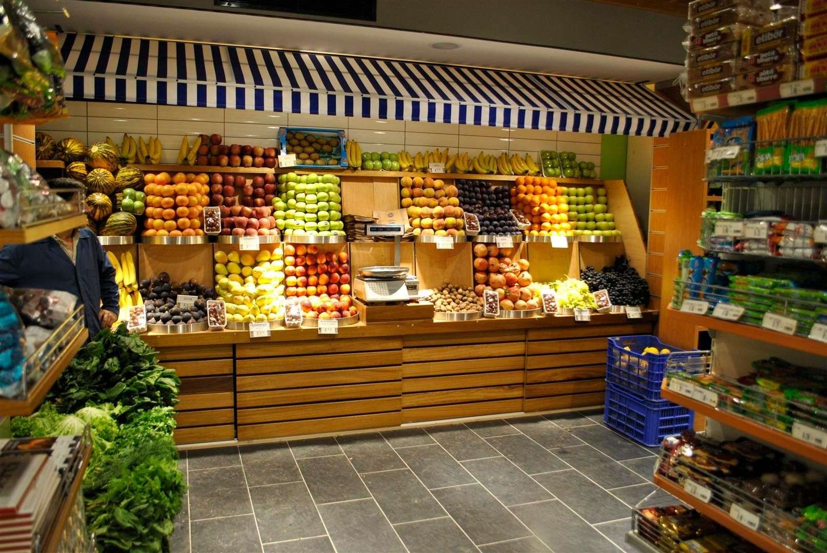

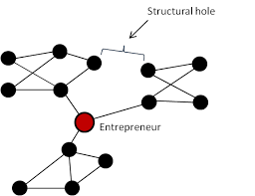
Consumers and Price
Do Consumers Always Choose based on Price? The Advantages of Knowledge, Social Networks, and Moral Standards that Compel you not to Desert the Well known.

Slide 3
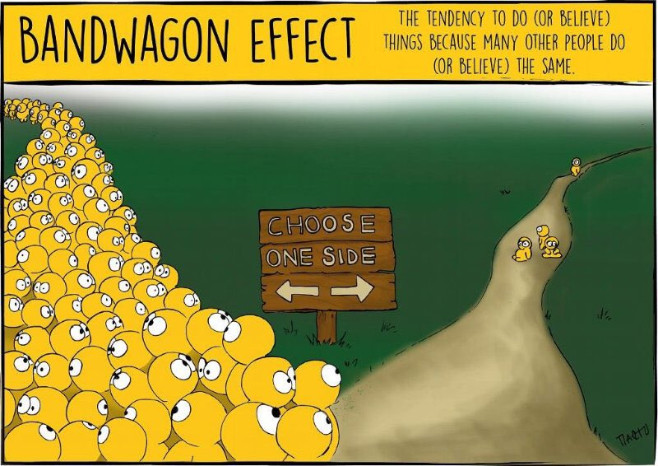
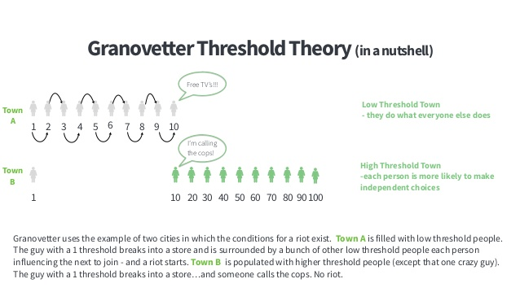
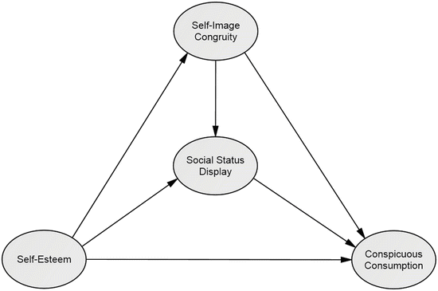
Consumers and Function
Do Consumers Choose by Function? Consumption is more than the Fulfillment of Needs and the Expression of a Preference. Conspicuous or ostentatious consumption and the social production of needs. Bandwagon Effects and Threshold Effects in the Production of Fads and Fashions. The cultural dimension of consumption.

Slide 4
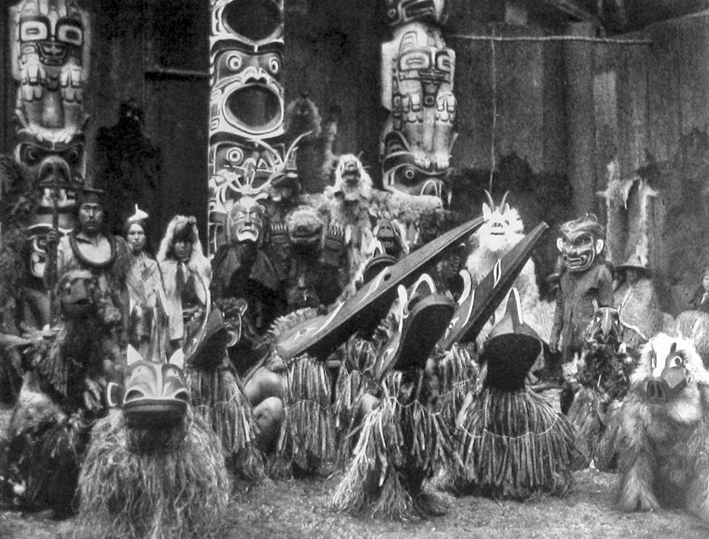
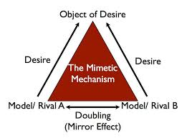
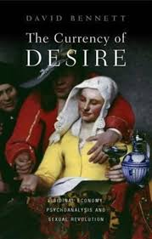
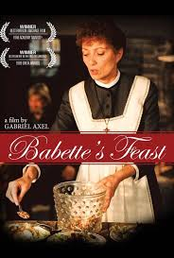
The Alienable and the Inalienable
Consuming a Good Eliminates that Good from the Economic Circuit? What is Alienable and what is Inalienable. The Potlatchian Strands of Economic Circuits. The Social Production of Needs. To desire is to make oneself desired. Consumption as Desire. Libidinal Forms of Consumption. The Ways of Converting Goods into Gifts and Gifts into Goods.

Slide 5
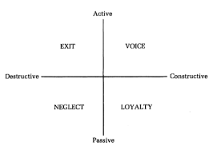
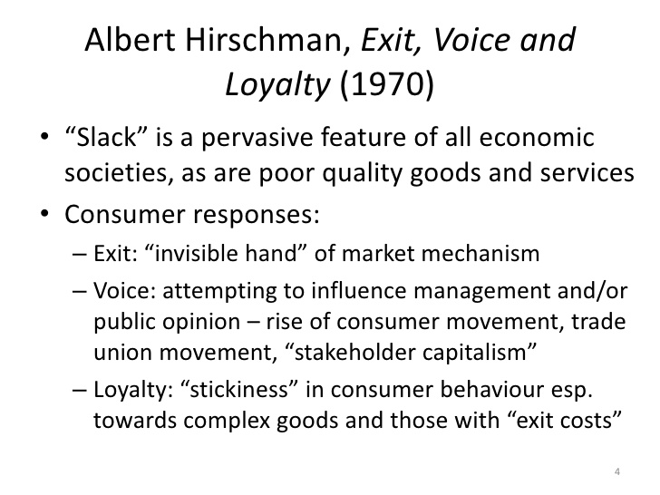
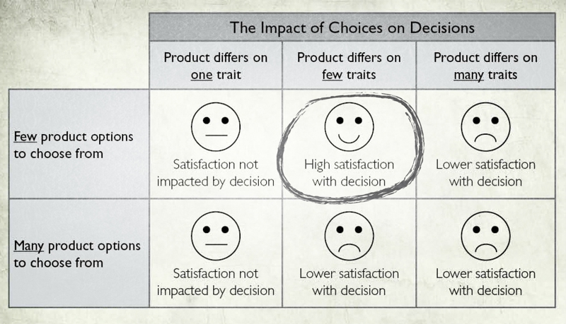
Choices and Competition
Do Monopolies Harm the Consumer and Reduce Choices? The Competition May Generate Multiple Alternatives and Minimal Options. Rigidity of Choice in Competition Liberalization Frameworks. From Nigeria's railways to television markets, with some forays into Hirschmanian models of Exit-Voice-Loyalty.

Slide 6
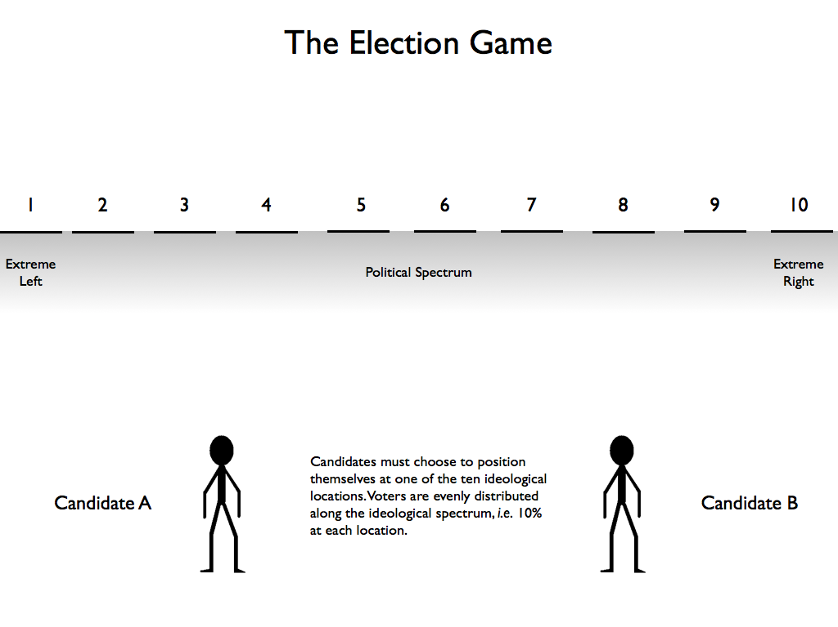

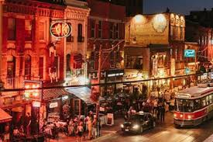
Downsian Analysis
In a Market with Normal Distribution, Do Producers Focus on Maximizing Customers? Models of Hotelling-Downs and their Political Derivations. The Case of Antiquaries. What are the Chances of Overcoming the Concentration Model?

Slide 7
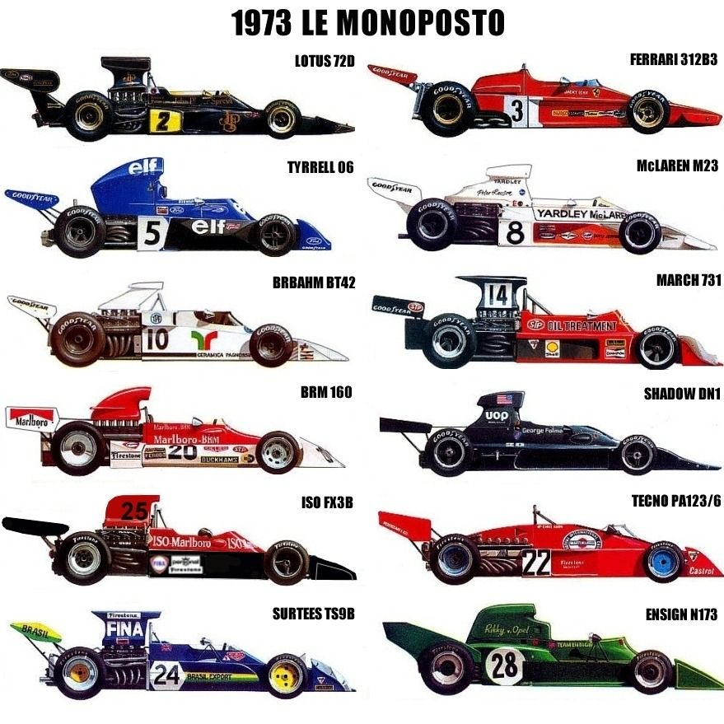
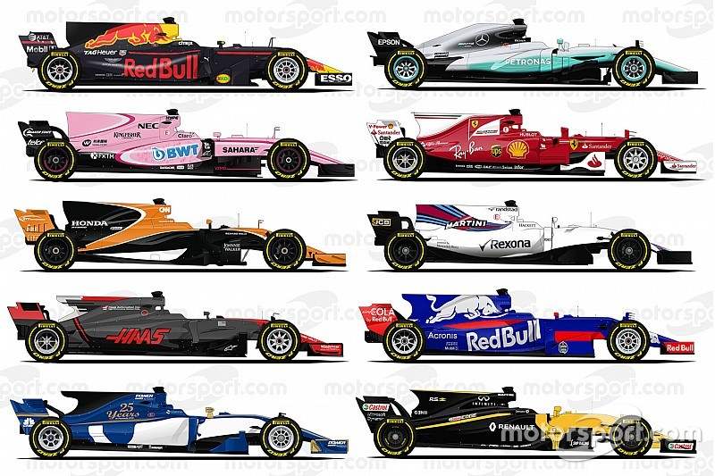
Diversity and Isomorphism
Does Competition Lead to Product Diversification? Homogeneity Frames and the Social Conditions of Isomorphism. Mimetic, Coercive and Normative Mechanisms in the Formation of Industries, Companies and Products in Contemporary Societies.

Slide 8

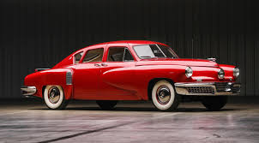
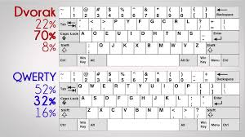
Efficiency and Legitimacy
Does Efficiency Guarantee the Survival of Activities, Companies and Industries? Legitimacy Prevails over Efficiency. The Excellencies that Die and the Weaknesses that Thrive. The QWERTY, Tucker, Betamax Cases and the Italian Civil Service Departments.

Slide 9

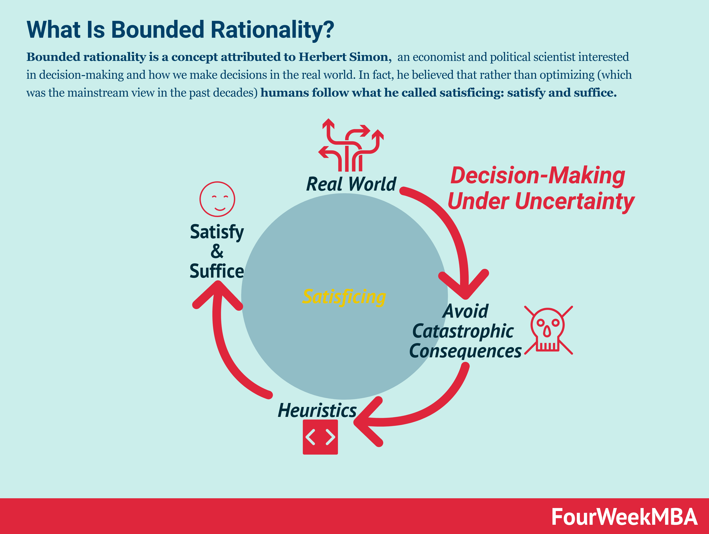
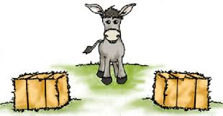
Satisficing
Are Economic Agents Rational and Utility Maximizers? According to Budget Constraints? The Cognitive Revolution. Satisfaction Criteria and Logics of Limited Rationality. From Rational Choice to Good Choice. The Salvation Heuristics. Rules of Thumb and Buridan's Donkey. Frank's Paradoxes or Why Leave Tips in Places We Won't Visit Again. The Commitment Schemes.

Slide 10
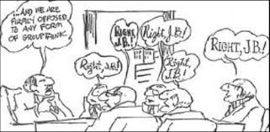

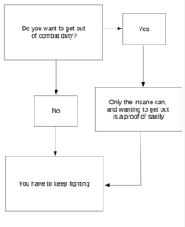
Frameworks
Are Economic Agents Well Behaved and Have Clear Choices? Neither Risk Lovers, Nor Risk Averters. Submission to Relevant Social Frameworks. Fragile, Doubtful and Wrong Decision Criteria. Groupthink Syndrome, Abilene Paradoxes and other Decision Deficiencies.

Slide 11
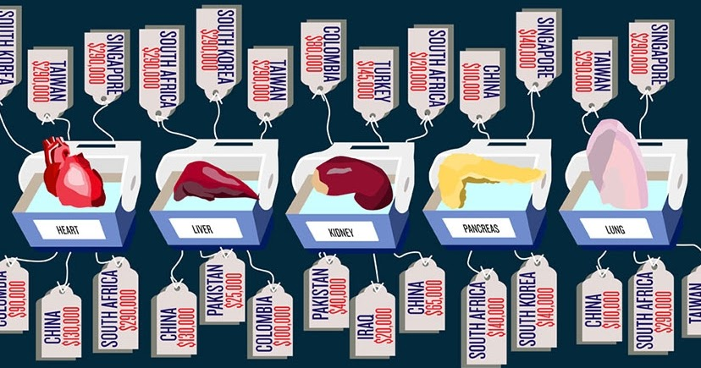
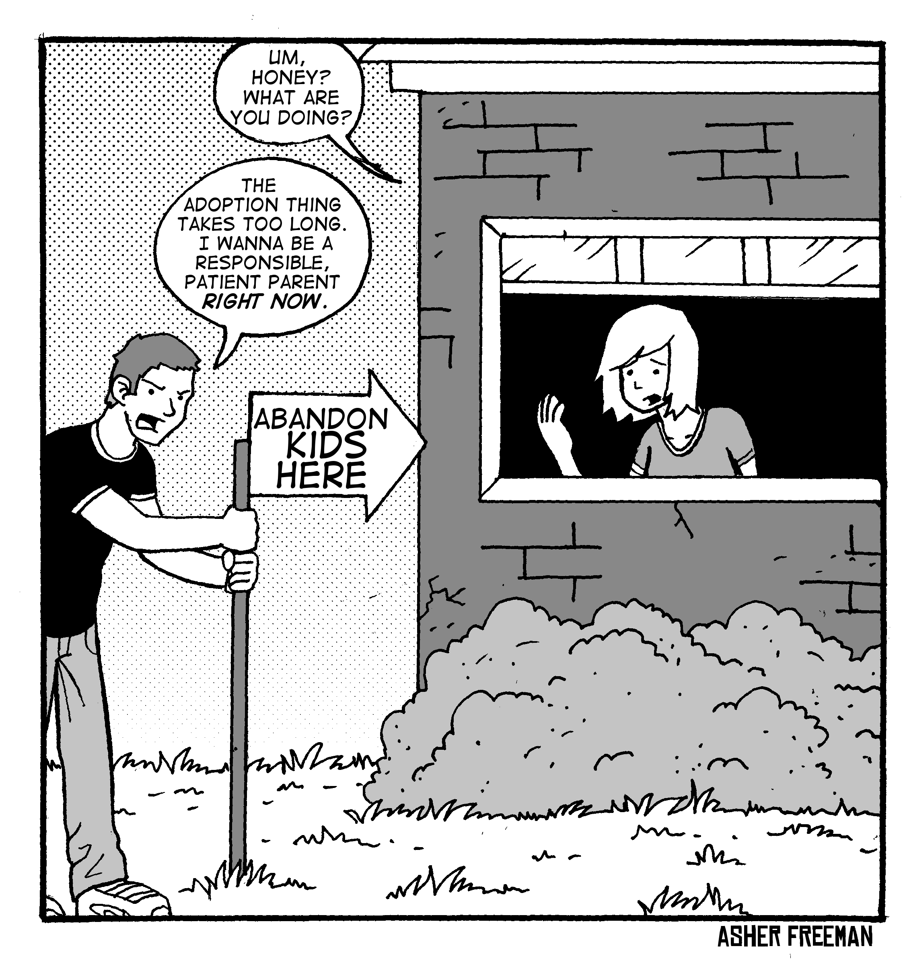
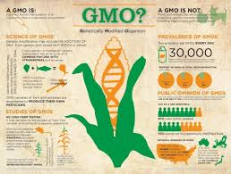
Gray Areas
Do Markets Ensure Better Quality and More Efficiency? Strange and Imperfect Markets. The Case of Adoptions. The Drug Case. What to Do with Blood and Organs. Titmuss Revisited. Crowding-Out and Spillovers effects. The Demoralization of Mercantilization.

Slide 12
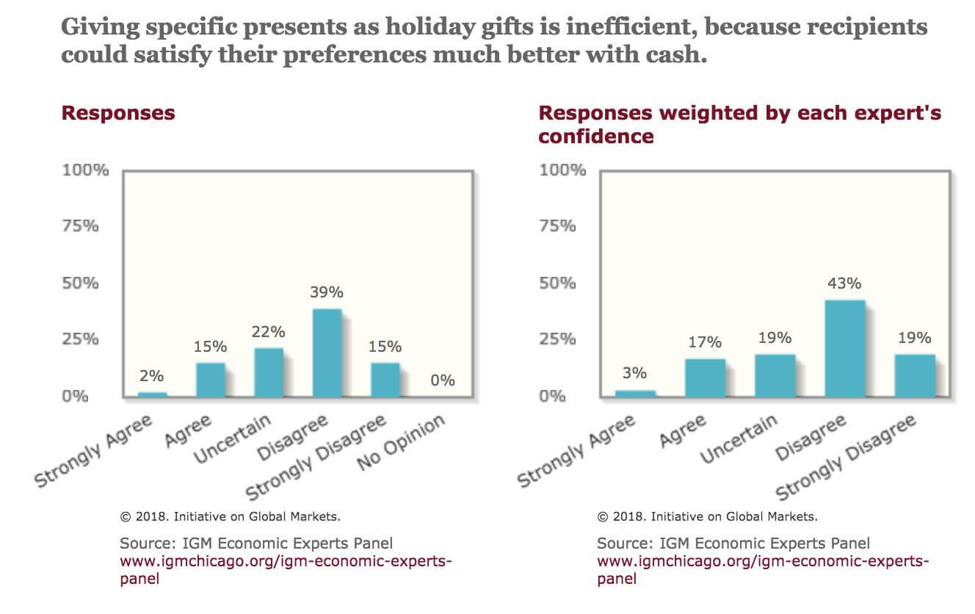

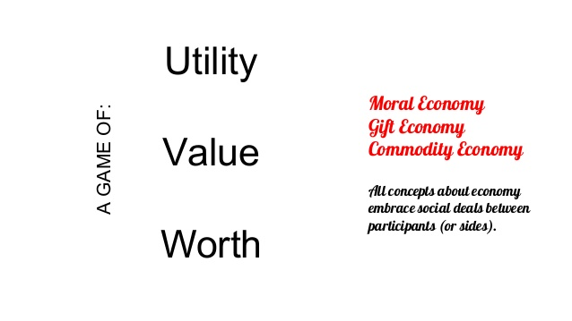
Moral Economies
Is the Organization of Exchanges by the Market a Creator of Value? The Deadweight Loss of Christmas Debate. Moral Economies. What is a Perfect and Pure Gift?

Slide 13
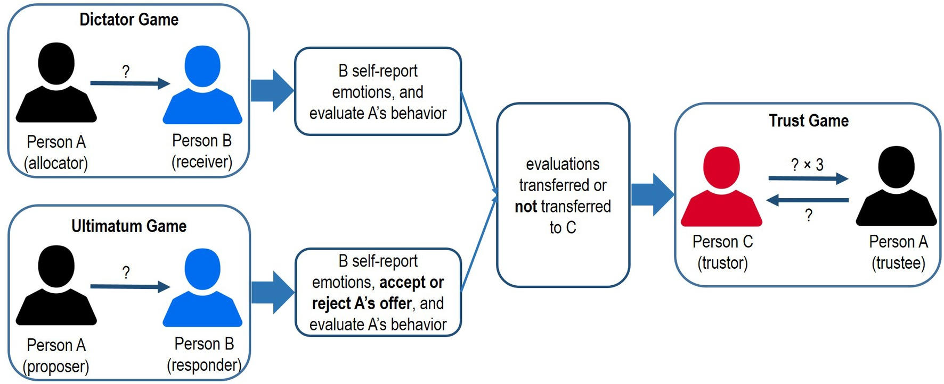
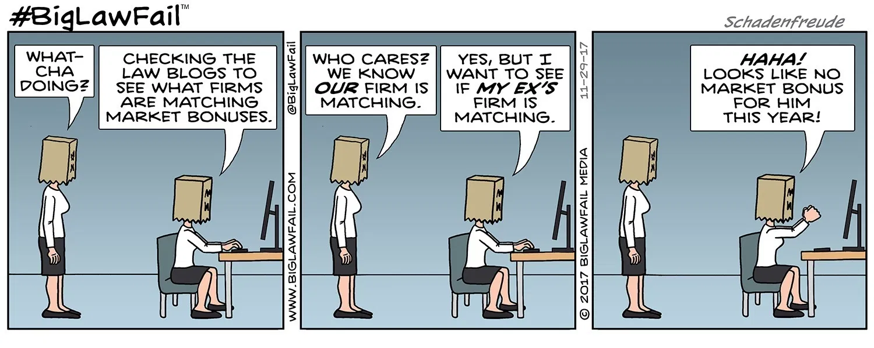
Homo Reciprocans
Is the Economic Agent a Homo Oeconomicus? The Social Actor does not move only by utilitarian logic. Homo Reciprocans or Why You Can Prefer Less to More, in Contexts of Interpersonal Comparison. The Validity of Equity Rules in Asymmetric Peer Distribution Systems. Distributions between Peers and Between Unequals. Trends for Social Stabilization and Change.

Slide 14


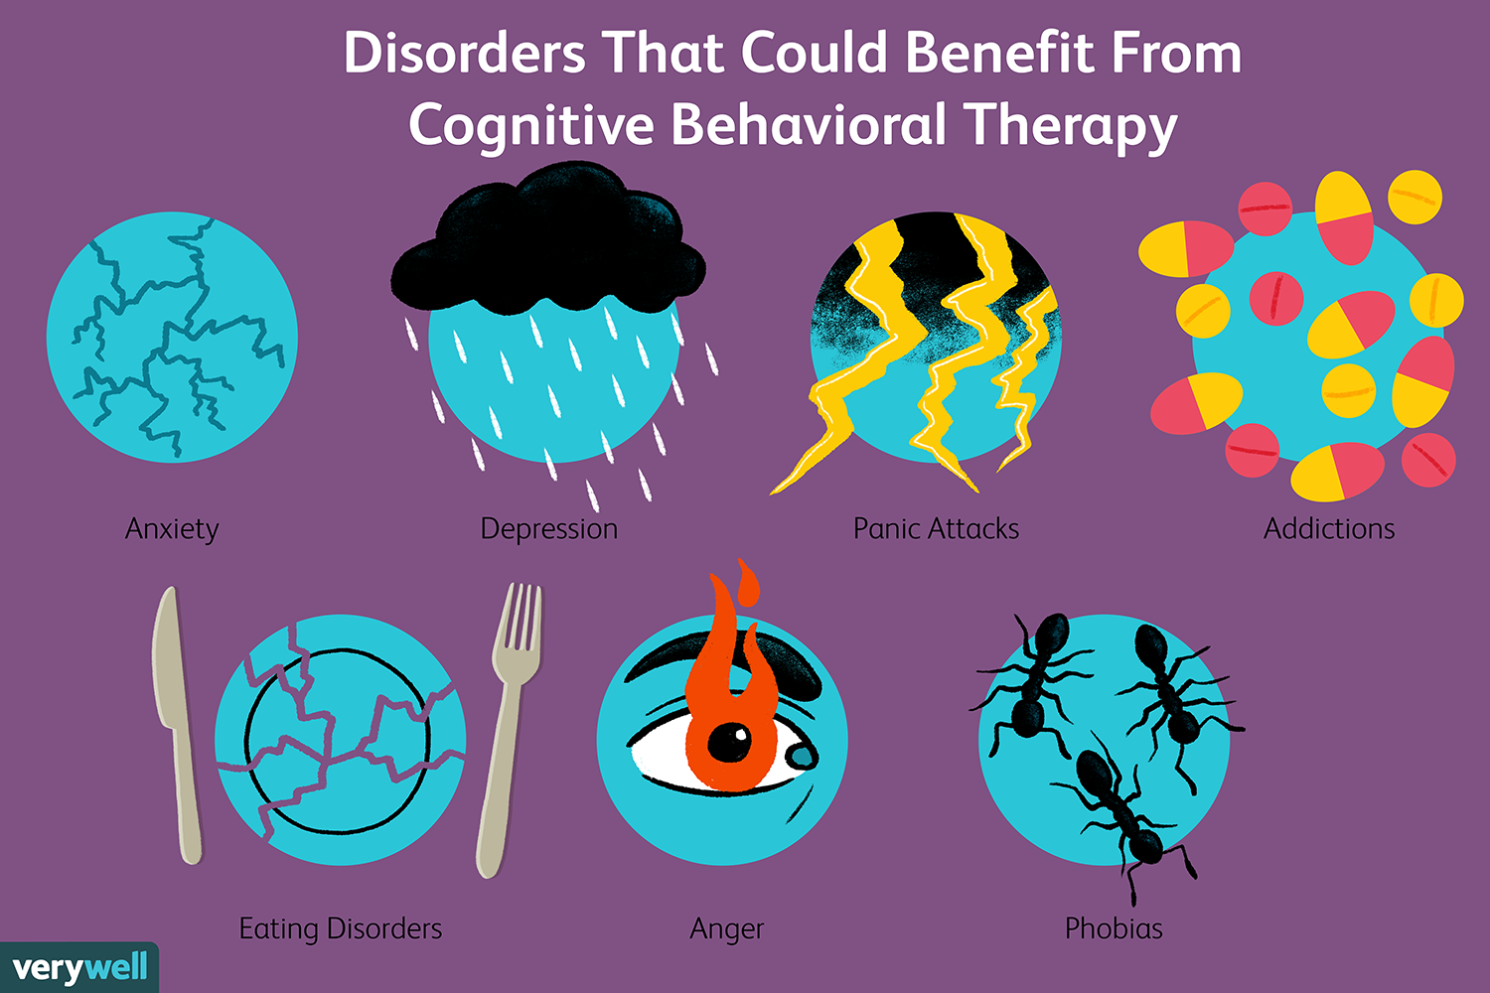
New Industries
Do New Industries Meet New Needs? Social Mechanisms for the Creation of Industries in Advanced Societies. Mechanisms for Counseling, Therapy and Regulation in Modern Democracies. Dissent Cooptation Schemes and their Channeling for the Fueling of New Industries.

Slide 15
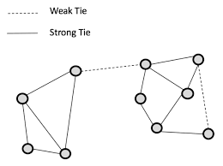
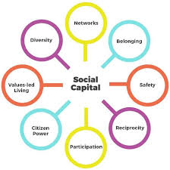

Social Ties and Networks
Do Markets Ensure Transparency and Create Value, Thanks to Anonymity and Efficiency? The Weight of Social Networks and Nepotism. Strong Ties and Weak Ties in Job-Search Contexts. Trust and Social Capital as Engines of Economic Activity.

Slide 16
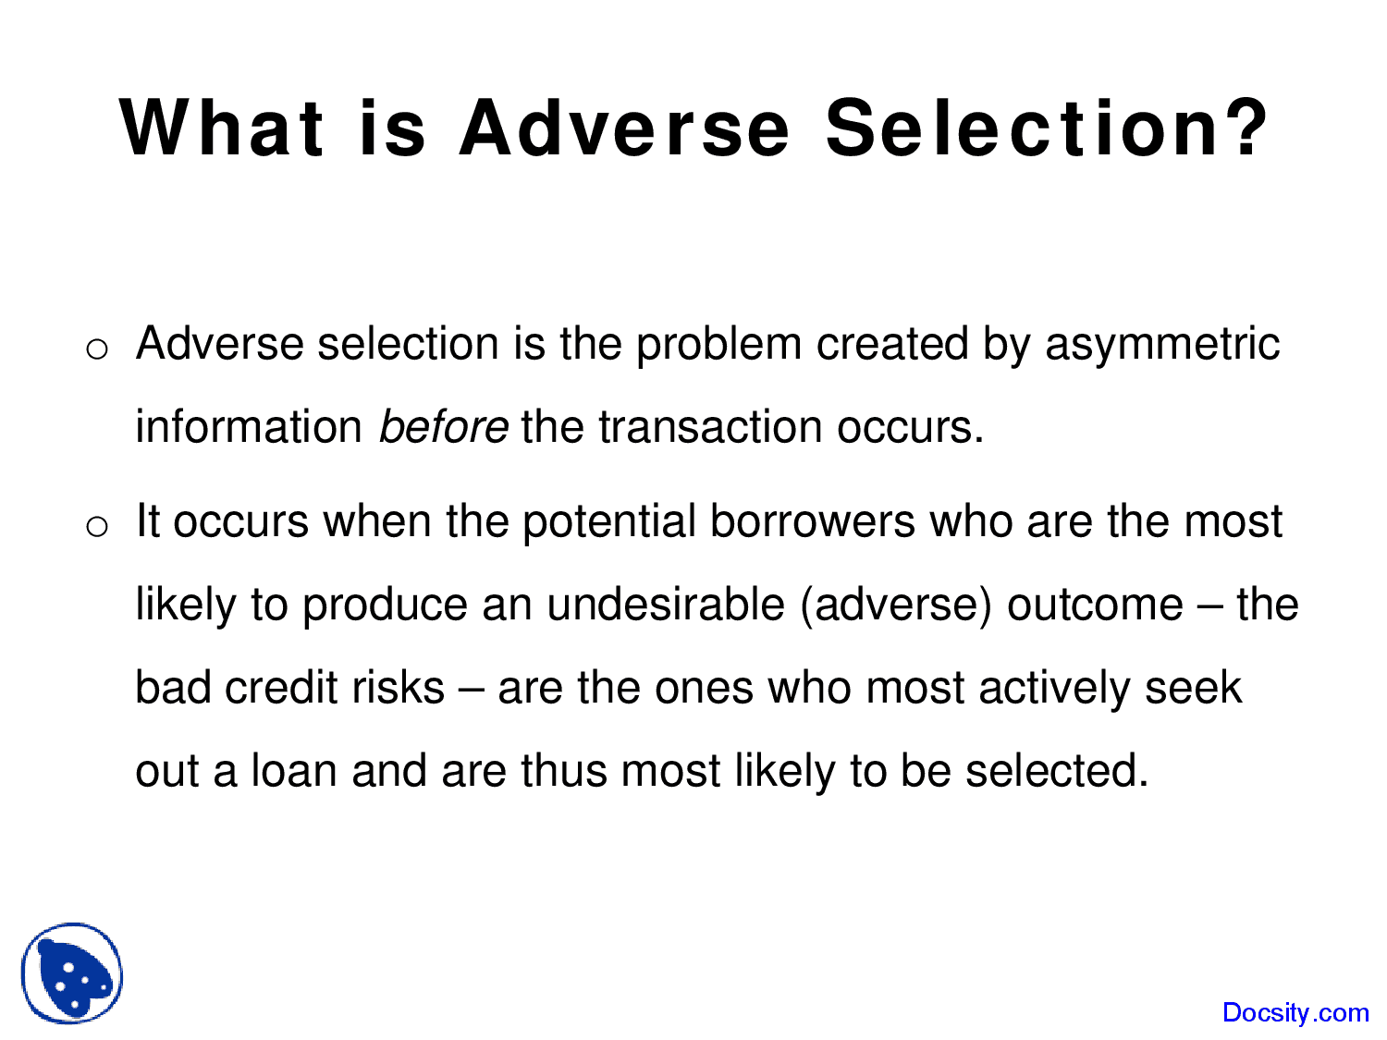

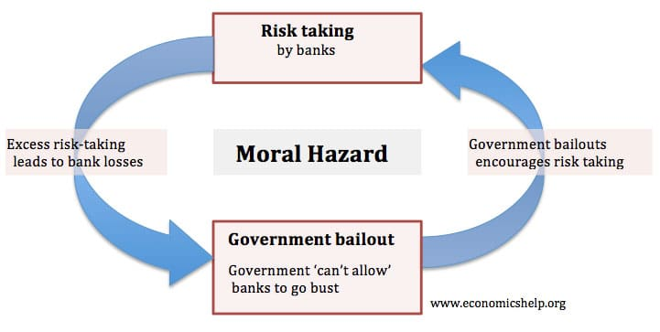
Reputation and Trust
Are Economic Activities Regulated either by the Market or by the Firm? The Logic of Transaction and Authority Costs. Sub and hyper-socialized solutions. Moral Hazard and Adverse Selection. Contract Costs. Protection Clause. Reputation, Repetition of Interactions and Trust.

